Slide 1
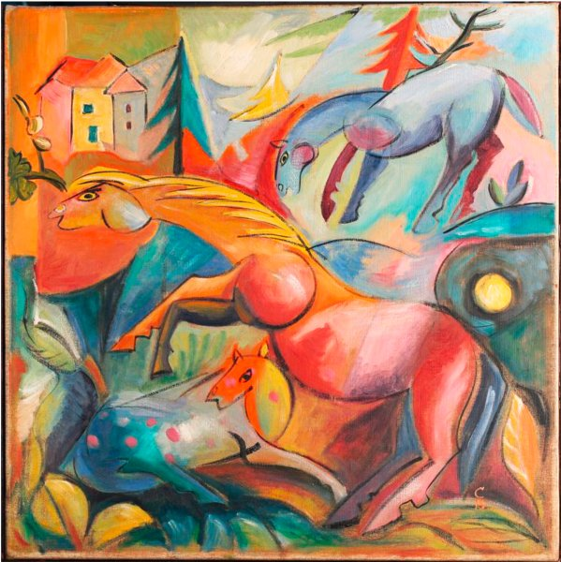
Landschaft mit Pferden
By: Heinrich Campendonk

Slide 2
Landschaft mit Pferden
By: Wolfgang Beltracchi

Slide 3
Learning to Walk in Obedience
1 John 2:3-6

Slide 4
The Test Stated 1 John 2:3
Can we really know Christ? Jn 17:3
Yes, personally and intimately
We know Christ if we keep his commandments. 1 Jn 2:3
Christ must be experienced: Phil 3:8, 10-11

Slide 5
The Test Failed: 1 John 2:4
Testimony of time past vs current conduct
Hosea 4:1 “Knowledge of God”

Slide 6
The Test Passed 1 John 2:5-6
If you love me, you will keep my commandments: John 14:15, 21, 23
What does obedience look like?
Immediate
Willingly
Long term

Slide 7
The Test Passed 1 John 2:5-6
Is this legalistic? Matthew 7:21
What are the commands of Christ?
Love the Lord your God: Matt 22:37
Love your neighbor as yourself: Matt 22:39
Repent: Matt 3:2
Sermon on the Mount: Matt 5-7

Slide 8
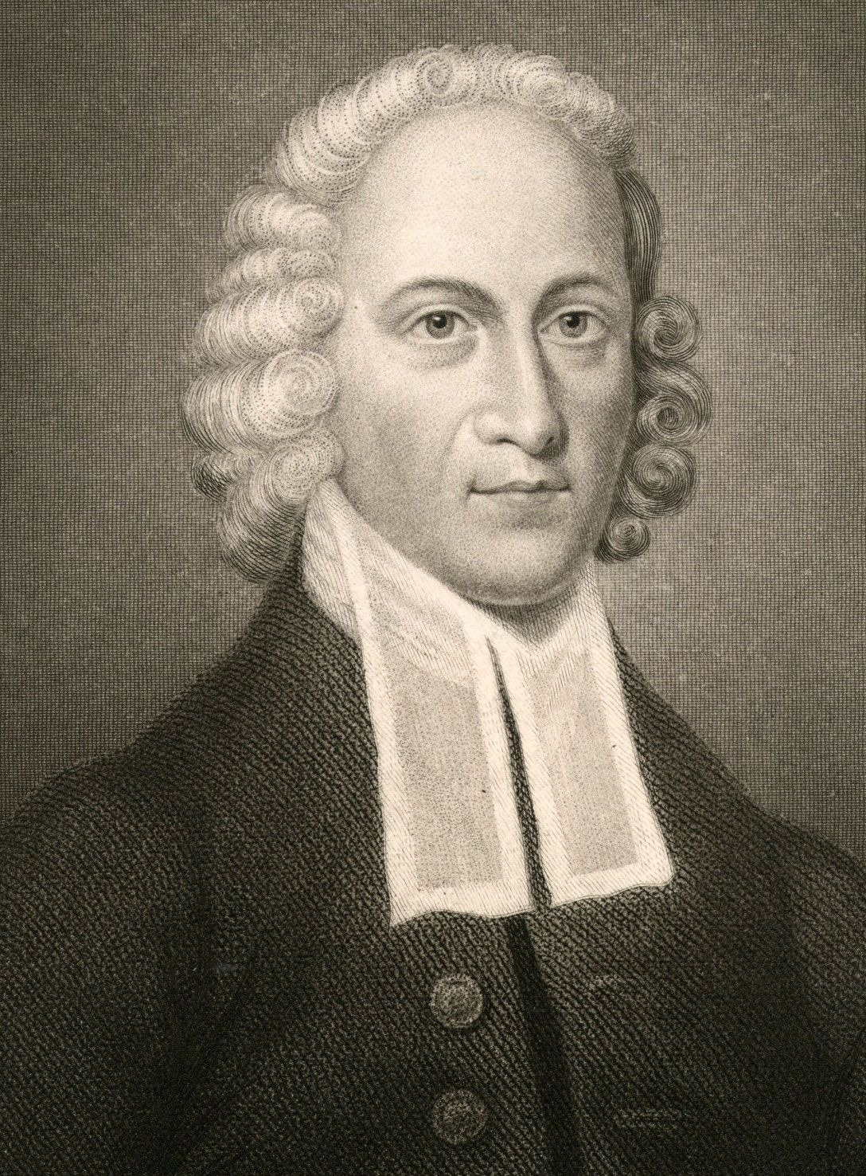
The Test Passed 1 John 2:5-6
Walking like Jesus = Changed life
Jonathan Edwards
1703-1758

