Slide 1
Touch of the Master
Matthew 9:18-26

Slide 2
Urgent Plea (18-19)
Mark 5:21-43, Luke 8:41-56

Slide 3
Unplanned Pause (20-22)

Slide 4
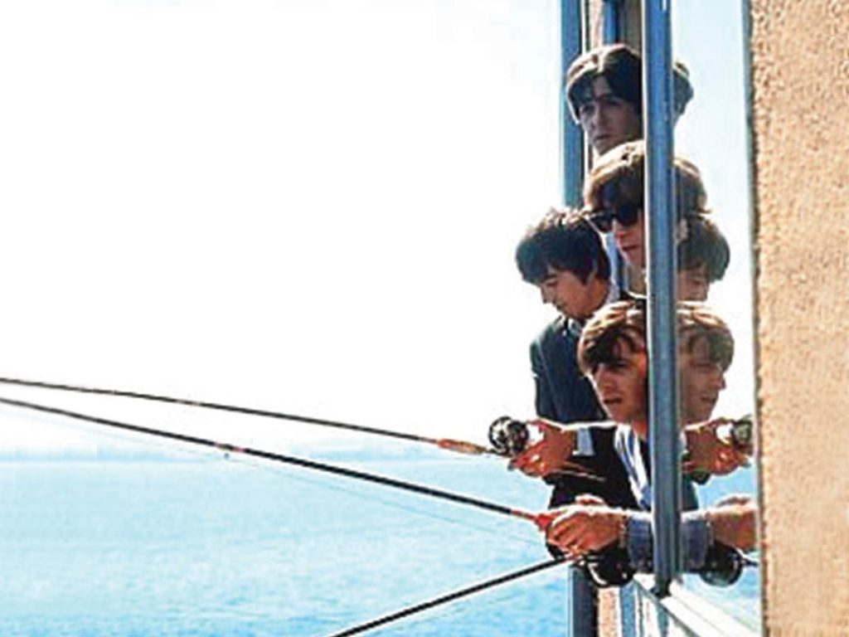
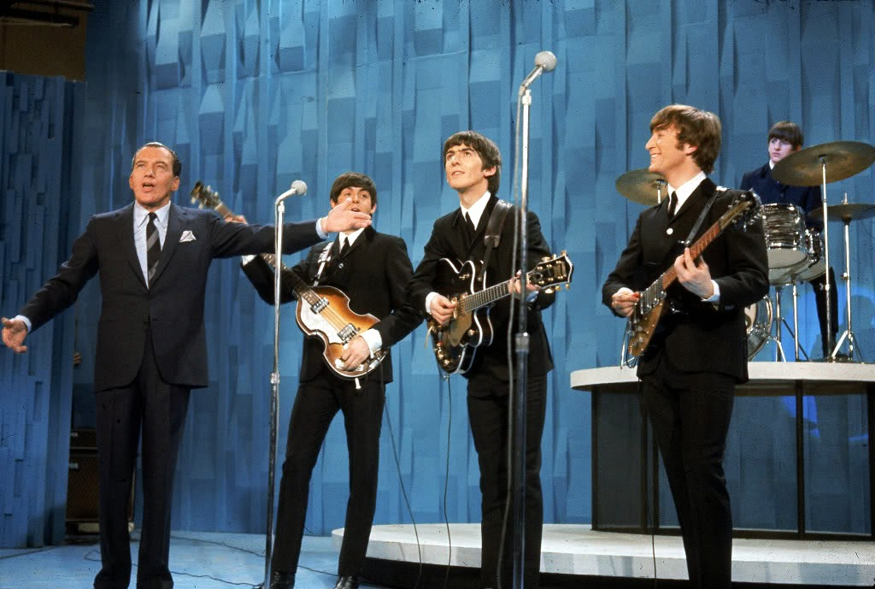

Slide 5
Unplanned Pause (20-22)
The disease:
A 12-year problem
A financial problem
A social problem

Slide 6
Unplanned Pause (20-22)
Touching the Master:
Tassels of prayer: Num 15:38-39
Immediate healing

Slide 7
Unplanned Pause (20-22)
The Master’s touch
Affection: He calls her daughter
Faith:
Well: Physical health & Spiritual health

Slide 8
Unprecedented Phenomenon (23-26)
Why does Jesus say she is asleep?
Lazarus: John 11:11
Stephen: Acts 7:60
500 witnesses: 1 Cor 15:6
The girl’s death was not final
Before Jesus’ authority death must flee
Death is stripped of its power

Slide 9
Unprecedented Phenomenon (23-26)
About the father:
His name was Jairus: Mk 5:22
Synagogue Official:
He demonstrated faith:

Slide 10
Unprecedented Phenomenon (23-26)
3 aspects of faith:
Knowledge: What does one believe
Intellectual Ascent: Conviction this is true.
Personal Trust: Acting in faith

Slide 11
Unprecedented Phenomenon (23-26)
Jairus’ faith:
Respect: He bowed
Jesus counters his fear with his faith
He believed in resurrection

Slide 12
Unprecedented Phenomenon (23-26)
Jesus was available
Jesus was empathetic
Jesus was touchable

