Slide 1
Fruit of the Spirit – Part 2
Galatians 5:22-23

Slide 2
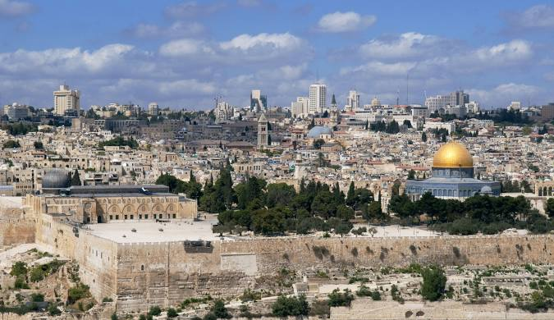
Peace
Salem/Shalom: completion, fulfillment, wholeness, unity, a restored relationship
Jeru-salem –
City of peace

Slide 3
Peace
Salem/Shalom: completion, fulfillment, wholeness, unity, a restored relationship Joshua 8:31, Ruth 2:12
Greeting: Rom 1:7
Absence of war:
Freedom from disturbance:
Opposite of troubled or anxious

Slide 4
Peace
Why don’t we have peace?
When Adam sinned all humanity fell into sin Genesis 3, Romans 5

Slide 5
Romans 5
Adam:
Enemies with God (10)
All sinned (12)
Many died (15)
Judgment /condemnation (16)
Death reigned (17)
Jesus Christ:
Reconciled to God (10)
Grace abounds (15)
Justification (16)
Reign in life(17)
Justification of life to all men (18)

Slide 6
Peace
Peace from God:
From the Father: Isaiah 26:3, 1 Chron 22:8-10
From the Son: John 14:27, 16:33, Is 9:6
From the Holy Spirit: Gal 5:22

Slide 7
Peace
The command for peace:
Blessed are the peace makers – Matt 5:9
Be at peace with all men – Rom 12:18
Let the peace of Christ rule in your hearts – Col 3:15

Slide 8
Peace
How do we let peace rule in our hearts?
Thankfulness
Let the Word dwell within you
Talk about the Word
Sing the Word
Prayer – Phil 4:6-7

Slide 9
Patience
A state of emotional quietness in the face of unfavorable circumstances.
Longsuffering, slow to anger

Slide 10

Patience
God is patient (slow to anger)
Exodus 34:6-7
Numbers 14:18
Psalm 86:15
Patience is associated with mercy & forgiveness
Long nosed

Slide 11
Patience
God is patient (slow to anger)
Exodus 34:6-7
Numbers 14:18
Psalm 86:15
Patience is associated with mercy & forgiveness
Long nosed
1 Peter 3:20

Slide 12
Patience
Command to be patient:
Colossians 3:12-13
Ephesians 4:1-2
2 Timothy 4:2
James 5:7-8

Slide 13
Patience
Practicing patience:
Forgive one another:
Show preference to one another:
Prayer

Slide 14
Kindness
Very similar to goodness
A gracious attitude
A general disposition toward others

Slide 15
Kindness
Kindness of God:
Luke 6:35 He Himself is kind to ungrateful and evil men
Romans 2:4 The kindness of God leads to repentance
1 Peter 2:2-3 God’s kindness is experienced
Ephesians 2:7 God is rich in grace and kindness
Titus 3:4-5 Jesus appeared in kindness

Slide 16
Kindness
Command
Ephesians 4:32 Be kind to one another, tender-hearted, forgiving each other
Micah 6:8 Do justly, love kindness, walk humbly with your God

