Slide 1
Fruit of the Spirit – Part 4
Galatians 5:22-26

Slide 2
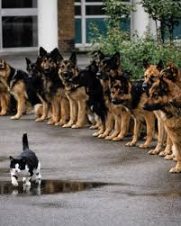
Gentleness/Meekness
Many believe meek = weak
Gentleness is strength under control, power harnessed

Slide 3
Gentleness/Meekness
Gentleness is learned:
Moses: saw himself in relation to God – Num 12:3
David: learned to fear the LORD – 1 Sam 26 & Psalm 18:35
Jesus calls us to learn from Him for He is gentle Matt 11:29

Slide 4
Gentleness/Meekness
Makes us teachable: James 1:21, 3:13
Consideration of others: Eph 4:2
A biblical command: 1 Tim 6:11
Wear the clothing of gentleness: Col 3:12

Slide 5
Self-Control
Mastery over desires & passions
Self control is the exercise of inner strength under the direction of sound judgment that enables us to do, think and say the things that are pleasing to God. (Jerry Bridges)
Habits: good & bad

Slide 6
Self-Control
Warning: Proverbs 25:28 A man without self-control is like a city broken into and left without walls.
Solomon is an illustration of his own proverb: Deuteronomy 17:16-17, 1 Kings 11:1-4

Slide 7
Self-Control
Principles for self-control (Jerry Bridges)
Acknowledge personal responsibility
Have a wall of defense: A wall in your mind
Self-denial in small things
Preach to yourself
Remove temptation: 2 Timothy 2:22

