Slide 1

Summer Series
The Holy Spirit

Slide 2

Psalm 139:7-10
Where can I go from Your Spirit? Or where can I flee from Your presence? If I ascend to heaven, You are there; if I make my bed in Sheol, behold You are there. If I take the wings of the dawn, if I dwell in the remotest part of the sea, even there Your hand will lead me, and Your right hand will lay hold of me.

Slide 3
Who is the Holy Spirit?

Slide 4
The Holy Spirit is a person
The Holy Spirit is always referred to as He or is called by a name/title. John 16:7
Intelligence, emotion, and will constitute personhood (Charles Ryrie)

Slide 5
The Holy Spirit is a person
Intelligence:
He knows and searches the things of God 1 Cor 2:10-11
He teaches people 1 Cor 2:13
He possesses a mind in Rom 8:26-27

Slide 6
The Holy Spirit is a person
Emotion/Feelings:
He can be grieved: Eph 4:30
He has a will:
1 Cor 12:11 The Spirit distributes spiritual gifts to individuals as He wills.
Acts 16:6-12 He directed Paul and his companions not to go through Asia

Slide 7
The Holy Spirit is a person
Actions of a person:
He convicts of sin: John 16:8
He guides us into truth by hearing, speaking, and showing: John 16:13
He performs miracles: Acts 8:39
He intercedes: Romans 8:26

Slide 8
The Holy Spirit is a person
He receives ascriptions that would be given only to a person:
He can be lied to. Acts 5:3
He can be resisted. Acts 7:51
He can be grieved. Eph 4:30
He can be blasphemed. Matt 12:31
He can be insulted. Heb 10:29

Slide 9
The Holy Spirit is God
Association with the Trinity: 16 times the Holy Spirit is connected with the Father or the Son
Acts 16:7 “The Spirit of Jesus”,
Rom 8:9 “Spirit of Christ,”
1 Cor 6:11 “you were justified in the name of the Lord Jesus Christ and in the Spirit of our God.”,
Matt 28:19 “baptizing them in the name of the Father and the Son and the Holy Spirit.”

Slide 10
The Holy Spirit is God
Another Helper: John 14:16
“I will ask the Father, and He will give you another Helper, that He may be with you forever.”
“heteros” means another of a different kind. Matt 6:24
“allos” which is another of the same kind. John 14:16

Slide 11
The Holy Spirit is God
Referred to as God:
Acts 5:3-4 “Why has Satan filled your heart to lie to the Holy Spirit… You have not lied to men but to God.”

Slide 12
The Holy Spirit is God
His attributes are those that belong to God alone:
The Spirit is omniscient: Is 40:13-14
Omnipresent: Ps 139:7
Eternal: Heb 9:14

Slide 13
The Holy Spirit is God
His actions are those that only God can do:
He caused the virgin birth in Luke 1:35.
He was the agent in giving the inspired Scriptures in 2 Peter 1:21.
He was involved in the creation of the world in Genesis 1:2

Slide 14
The Holy Spirit is God
Holy Spirit as YHWH
Acts 28:25-27 quoting Isaiah 6:8-10
Hebrews 10:15-17 quoting Jeremiah 31:33-34

Slide 15
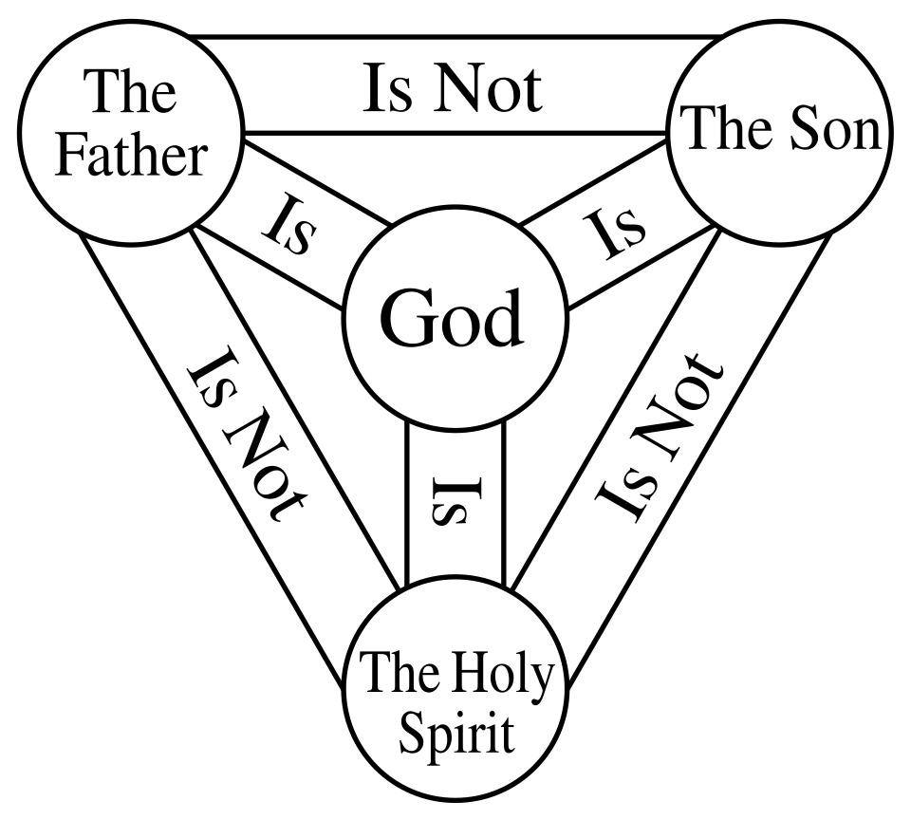

Slide 16
Promise of the Spirit
To the house of Israel:
Ezekiel 39:29
Joel 2:28 quoted in Acts 2:17
Zechariah 12:10 quoted in John 19:37
New Covenant:
Jeremiah 31:31-34,
Ezekiel 36:26-27
Hebrews 8:8-10, 9:15

Slide 17
Promise of the Spirit
New Testament:
Luke 11:13 “… how much more will your heavenly Father give the Holy Spirit to those who ask Him?”
John 16:7 I will send the Helper to you
Acts 1:8 “… you will receive power when the Holy Spirit has come upon you; and you shall be My witnesses …”

