Slide 1

Summer Series
The Holy Spirit

Slide 2

Sealing & Indwelling of the Holy Spirit

Slide 3






Sealing with the Holy Spirit

Slide 4

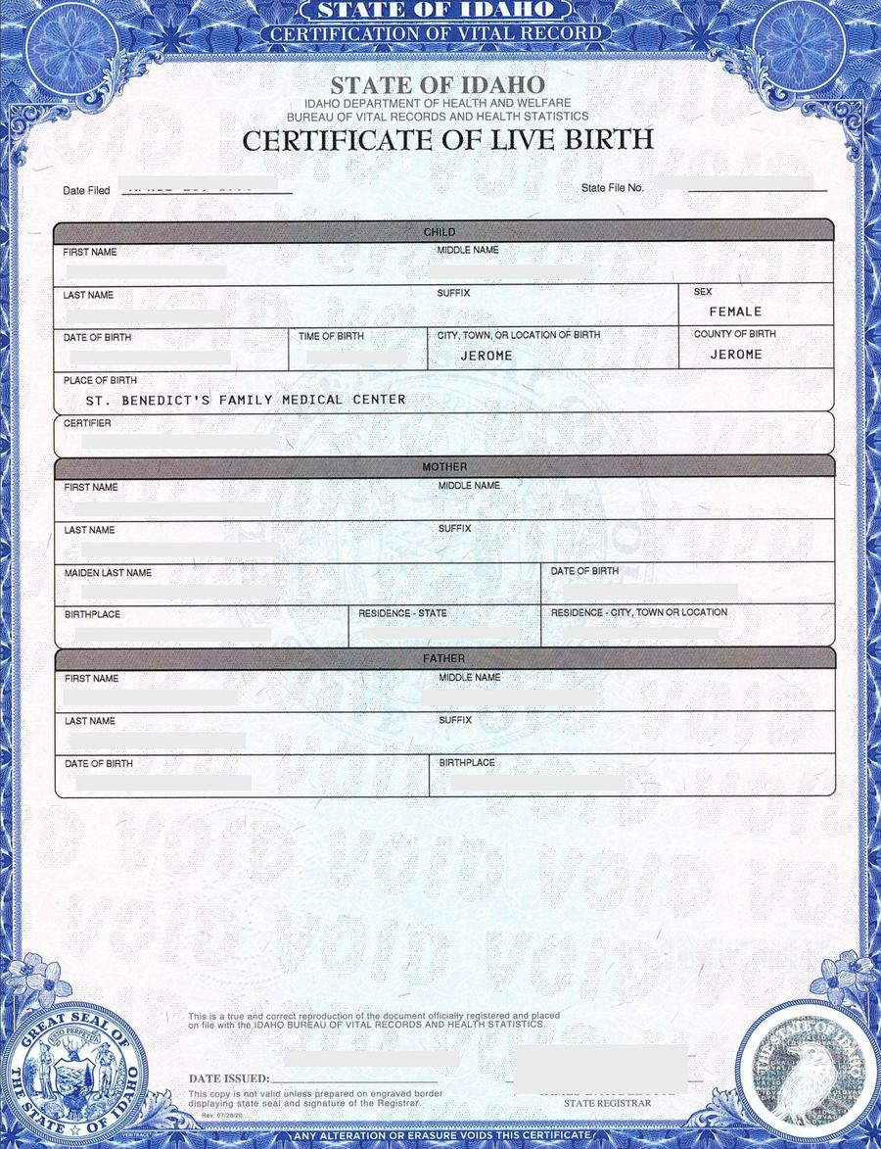
Sealing with the Holy Spirit

Slide 5
Sealing with the Holy Spirit
Authenticity: a true follower of Jesus Christ
Ownership: belonging to Jesus Christ
Security: Nothing can remove you from Jesus Christ

Slide 6
Sealing with the Holy Spirit
Seals in Scripture:
Daniel 6:17 – Lions den
Esther 8:8 – Kings seal may not be revoked
Revelation 5 – 7 seals of Judgment

Slide 7
Sealing with the Holy Spirit
Ephesians 1:13-14 – Your position is sealed in Christ with the Holy Spirit.
2 Corinthians 1:21-22 – God sealed you by giving you the Holy Spirit
Ephesians 4:30 – Sealed for the day of redemption

Slide 8
Sealing with the Holy Spirit
Pledge:
First installment (NASB 2020)
Guarantee of our inheritance (ESV, NKJV)
Deposit guaranteeing our inheritance (NIV)
Earnest of our inheritance (KJV)

Slide 9
Indwelling of the Holy Spirit
Romans 8:9-11
Dwell = Home
The Spirit dwells in believers
1 Corinthians 3:16, 6:19-20
Temple: Set apart for worship

Slide 10
Indwelling of the Holy Spirit
Old Testament believers who had the Spirit
Joshua: Numbers 27:18
Ezekiel: Ezekiel 2:2, 3:24
Saul: 1 Samuel 10:10
David: 1 Samuel 16:13
Moses, 70 elders, Balaam, Gideon, Sampson, Daniel

Slide 11
Indwelling of the Holy Spirit
New Testament believers
At salvation:
Inclusive of all believers individually:
Permanent:
Cohesive: the universal church
Empowerment for holy living and service

