Slide 1
John 10
Living Abundant Life

Slide 2
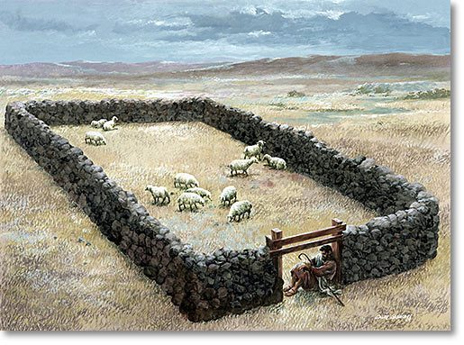
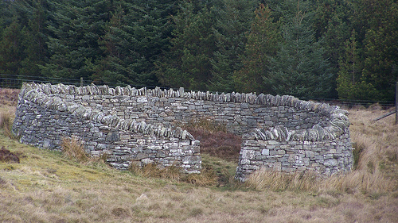

Slide 3
The Gate & The Good Shepherd
Thieves & Robbers: John 9:41-10:1
Jeremiah 23:1-2
Jeremiah 50:6
Ezekiel 34:7-10
Ezekiel 34:11-12 (God will shepherd…)

Slide 4
The Gate & The Good Shepherd
Gate: John 10:7

Slide 6
The Gate & The Good Shepherd
Good Shepherd:
Not Agathos: Moral quality
Kalos: constitutionally good, beauty, completeness, excellence

Slide 7
The Gate & The Good Shepherd
Listen/Follow because they know his voice: (3, 4, 14, 16)
He calls them by name: (3)
What is the fold: (1, 16) Israel - Acts 18:9-10
Lays down his life: (11, 15, 17-18)

Slide 8
The Guarantee
Present life: not only future
Abundant life:
Relationships
Bigger than yourself

Slide 9
The Guarantee
Salvation:
Serious:
Discernment: Titus 1:9
Serve: Without fear
Security: Romans 8:38-39

